Slide 1
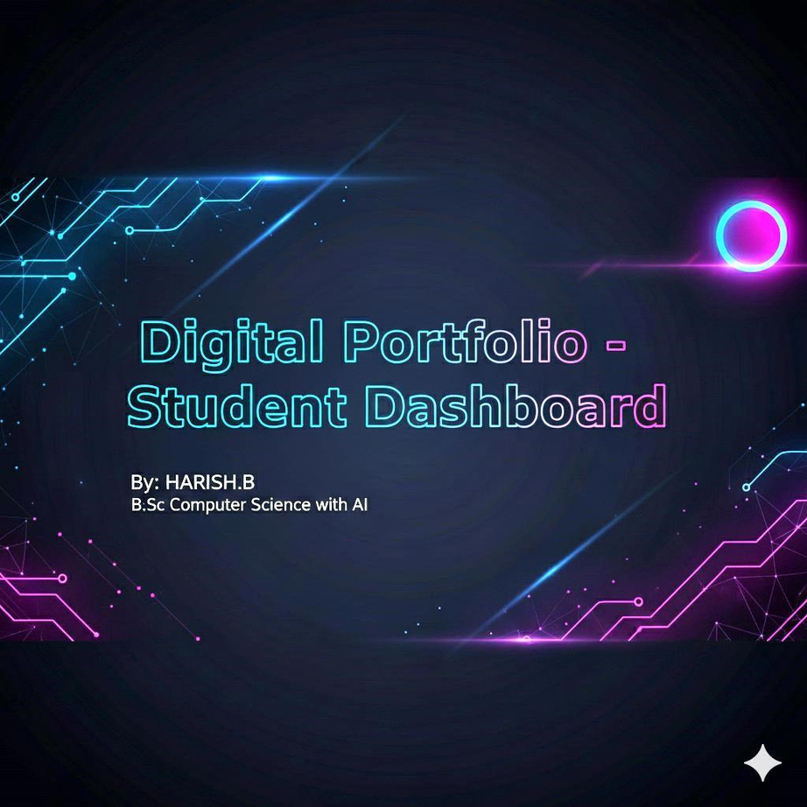


DägHta0 PortfoDüo
Student Dashboard
By: HARISH.B
B.Sc Computer Science with Al

Slide 2
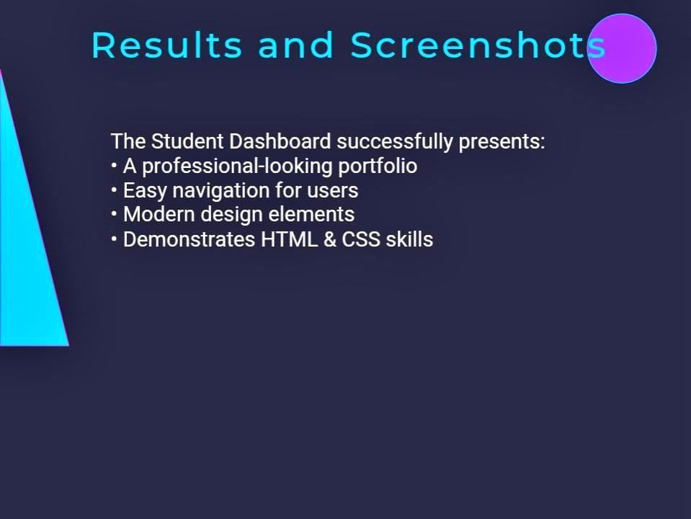




Results and Screenshot
The Student Dashboard successfully presents:
• Aprofessional-looking
portfolio
• Easy navigation for users • Modern design elements
•DemonstratesHTML &CSS skills

Slide 3
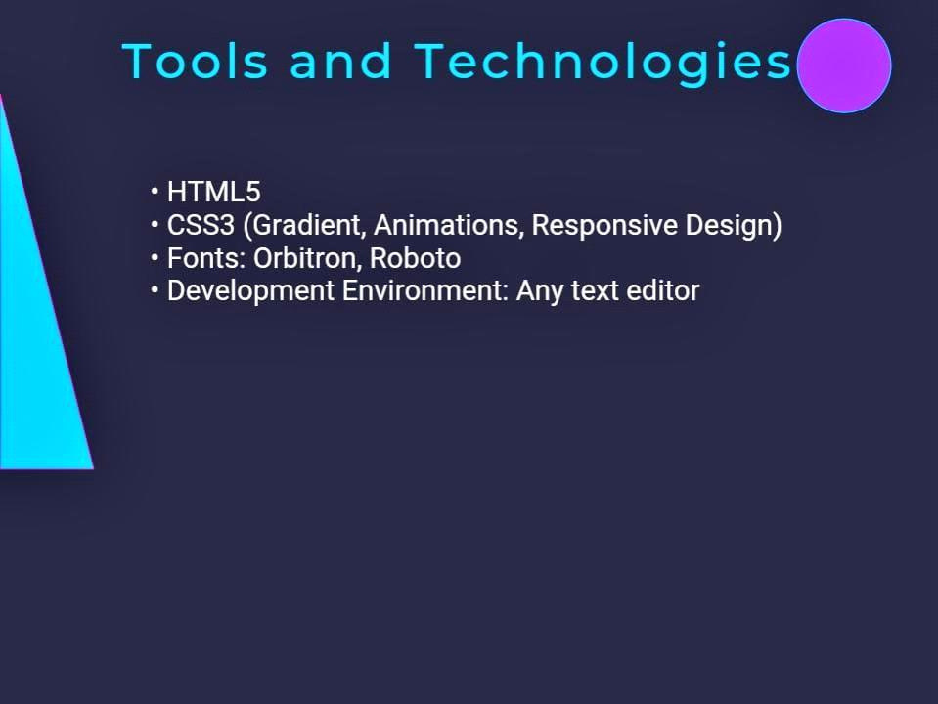



Tools and Technologies
• HTML5
•CSS3 (Gradient,Animations,ResponsiveDesign)
• Fonts: Orbitron,R oboto • Development Environment:A ny text editor

Slide 4
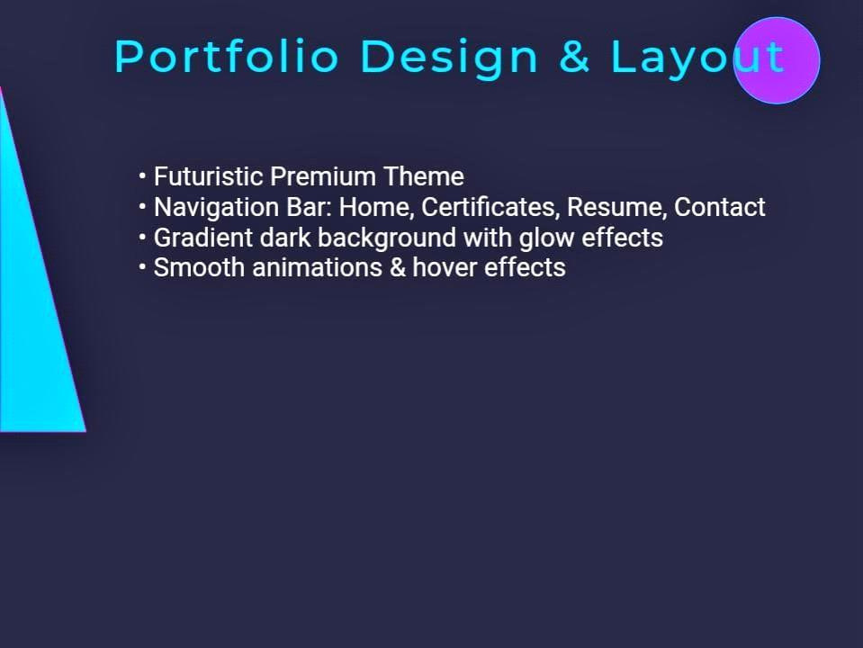




Portfolio Design & Layo
t
• Futuristic Premium Theme
• NavigationBar:Home, Certificates, Resume, Contact
• Gradient dark background with glow effects • Smooth animations & hover effects

Slide 5
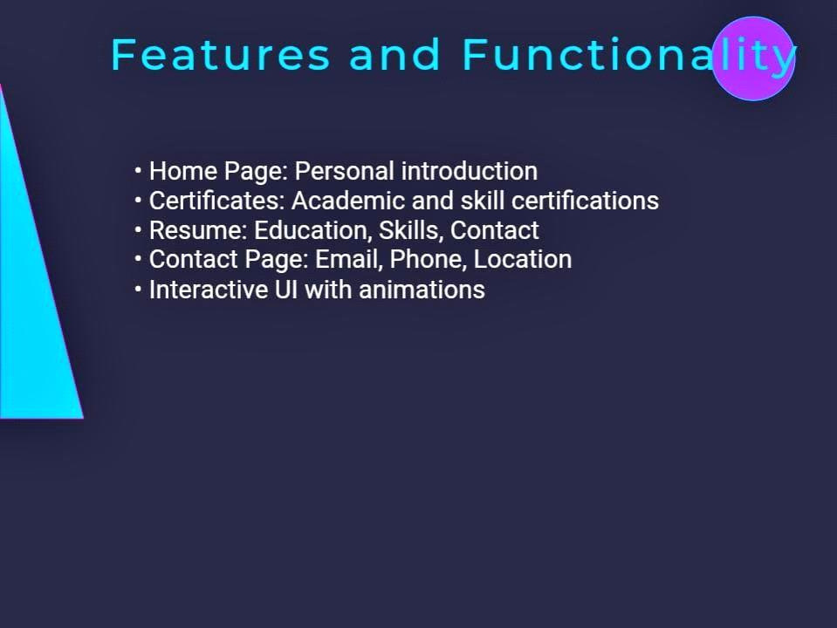



Features and Function
it
• Home Page: Personal introduction • Certificates: Academic and skill certifications
• Resume:Education,Skills,Contact
• Contact Page: Email, Phone, Location
• InteractiveUIwithanimations

Slide 6
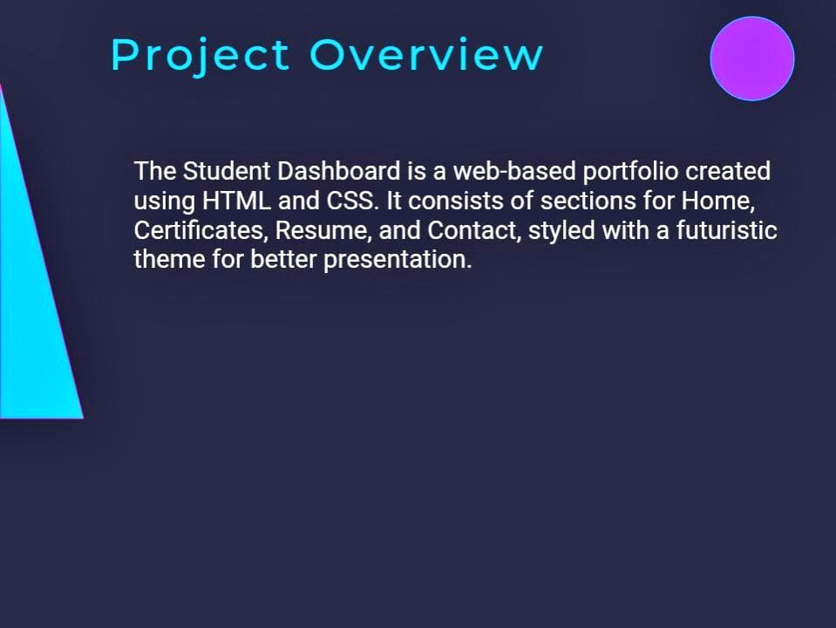


Project Overview
The Student Dashboard is a web-based portfolio created
using HTML and CSS. It consists of sections for Home,
Certificates, Resume, and Contact, styled with a futuristic theme for better presentation.

Slide 7
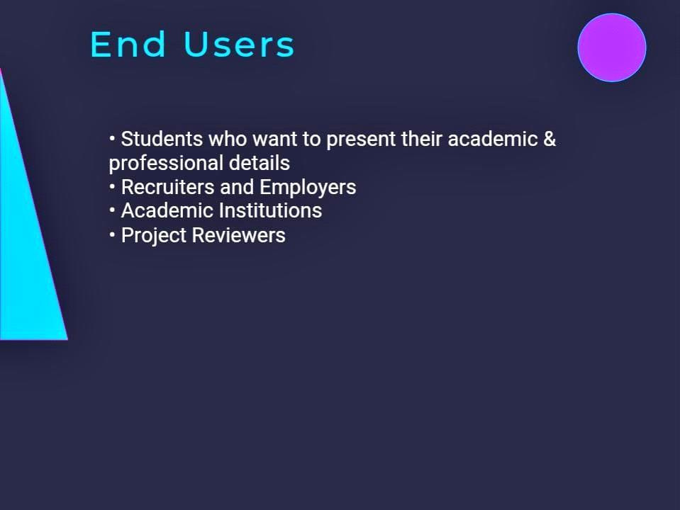



End Users
• Students who want to present their academic &
professional details
• Recruiters and Employers • Academic Institutions
• Project Reviewers

Slide 8
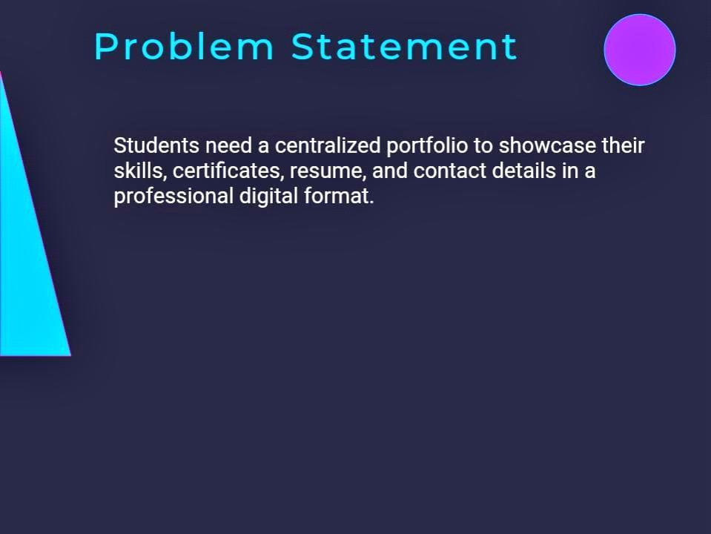



Problem Statement
Students need a centralized portfolio to showcase their
skills, certificates, resume, and contact details in a
professional digital format.

Slide 9
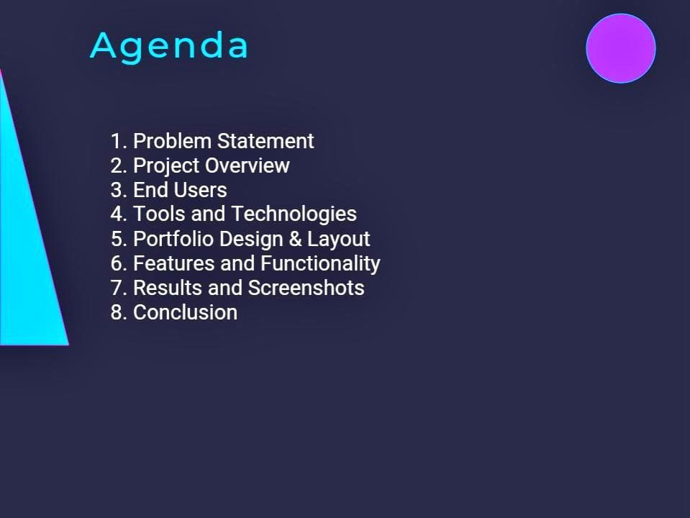


Agenda
1.Problem Statement
2. ProjectOverview
3. End Users 4. Tools and Technologies
5. Portfolio Design & Layout
6. Features and Functionality
7. Results and Screenshots
8. Conclusion

Slide 10
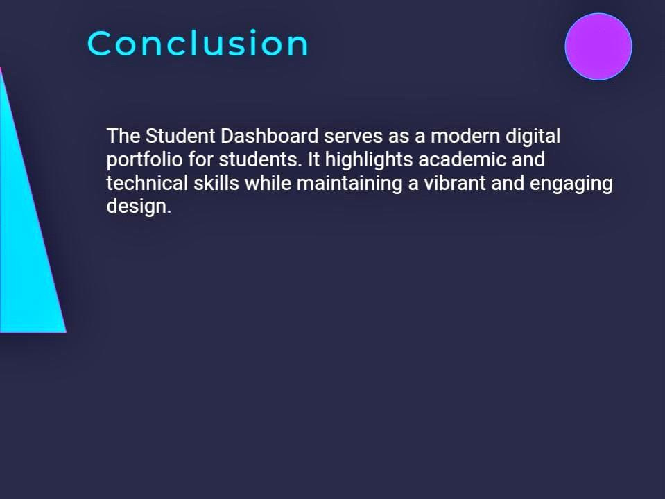


Conclusion
The Student Dashboard serves as a modern digital portfolio for students. It highlights academic and technical skills while maintaining a vibrant and engaging design.

